Slide 1

WELCOME TO:
General Meeting
6 PM Tuesday, October 30th, 2018
Broun Hall, Room 125

Slide 2
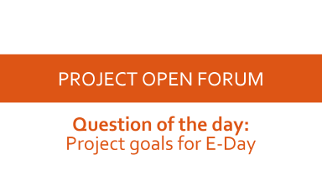

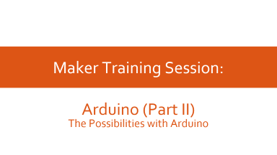
AGENDA

Slide 3
ABOUT SPARC

Slide 4
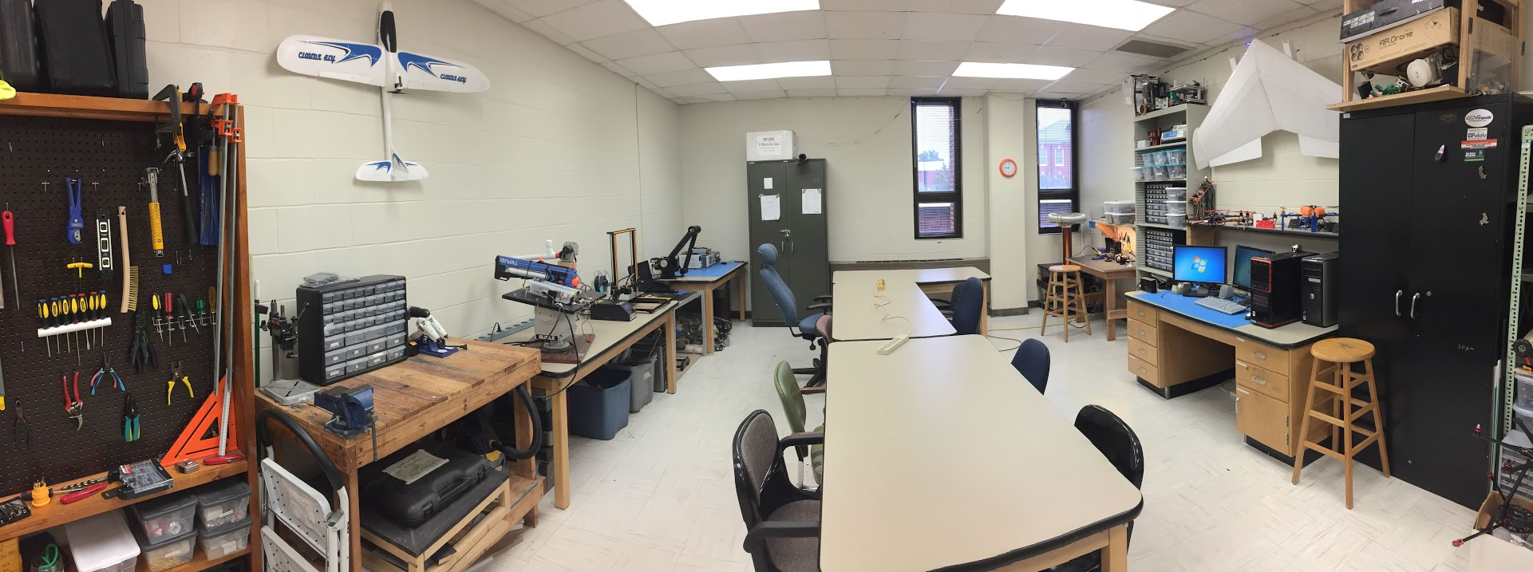
ABOUT SPARC
Creates and fosters an environment of creativity and innovation through collaborative projects.
A place to test out ideas, integrate concepts learned in class, and learn skills that will be instrumental when working in the workforce.
No prior experience is required, only a willingness to learn.
Lab:
- Broun 367
General Meetings:
- Tuesdays @ 6 in Broun 125
Project Meetings:
- Various Times during week

Slide 5
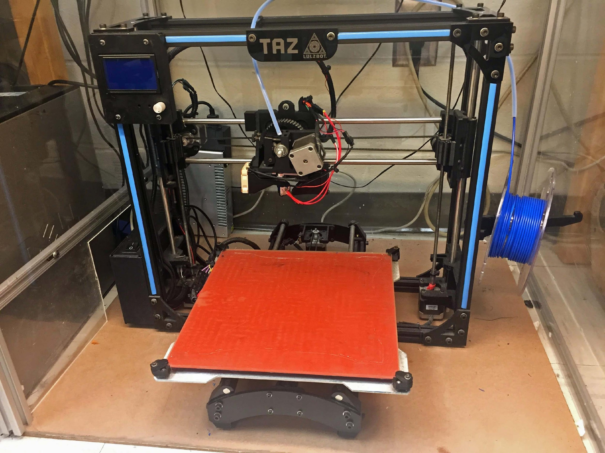
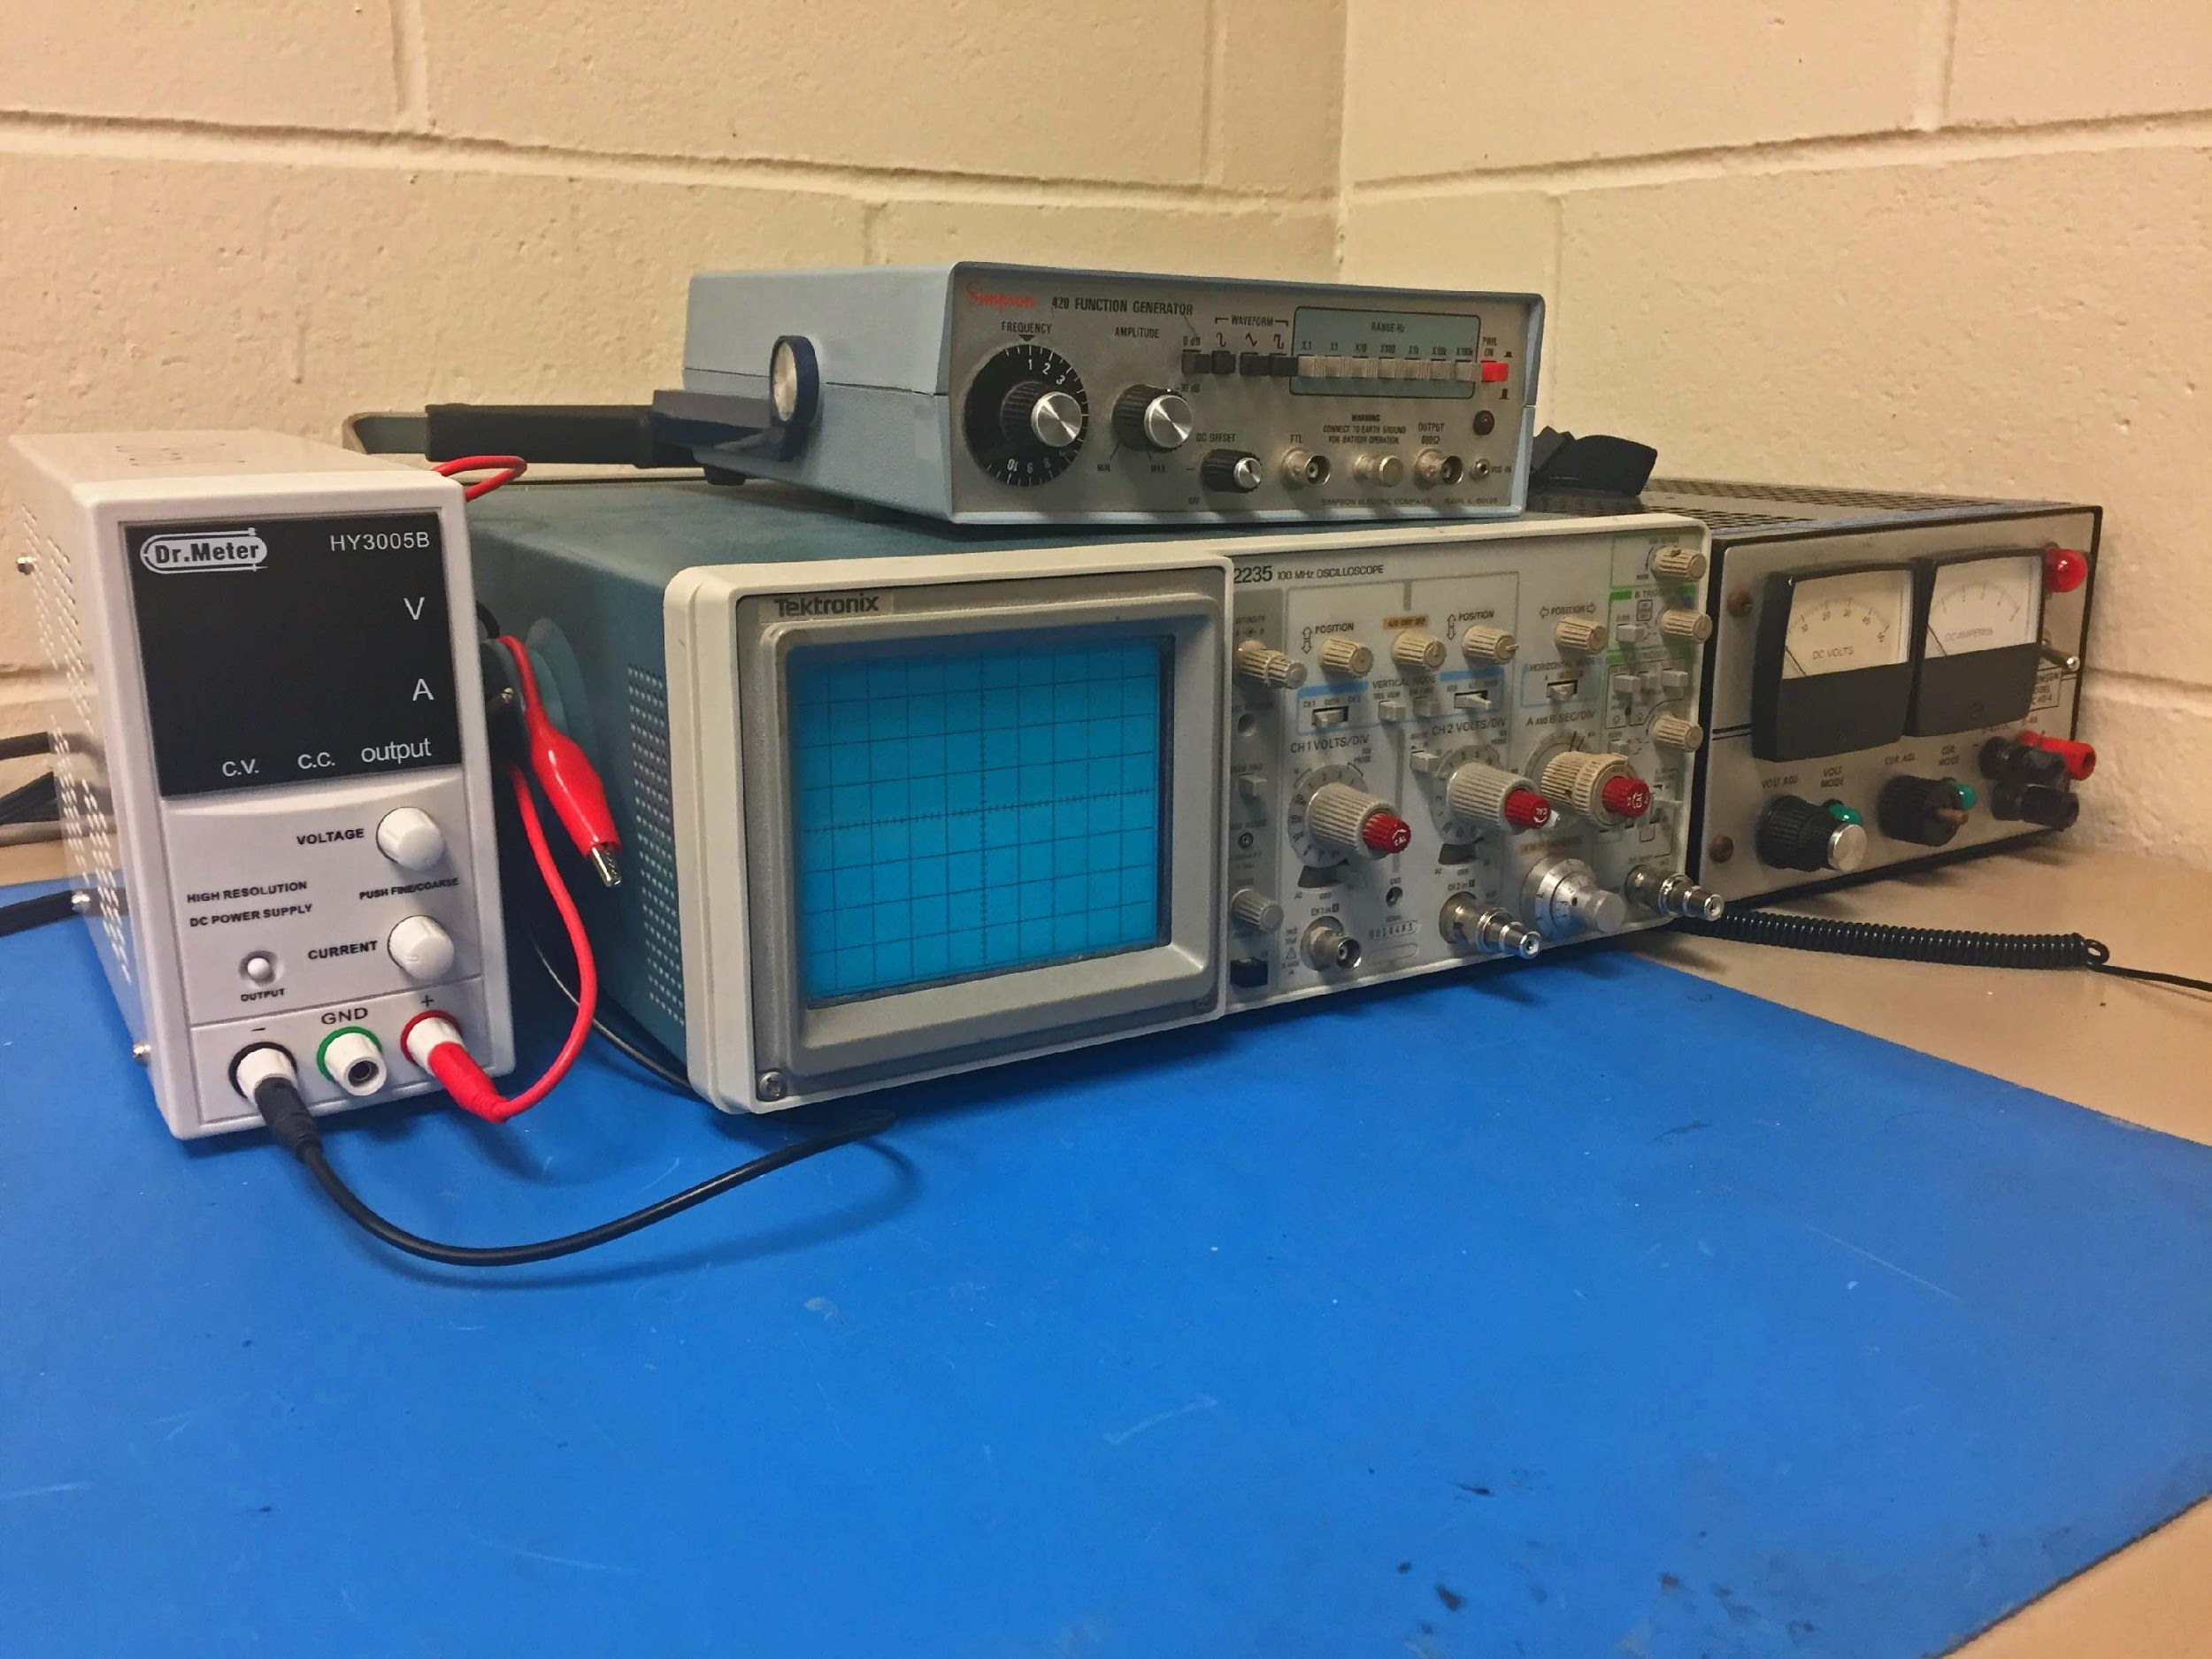
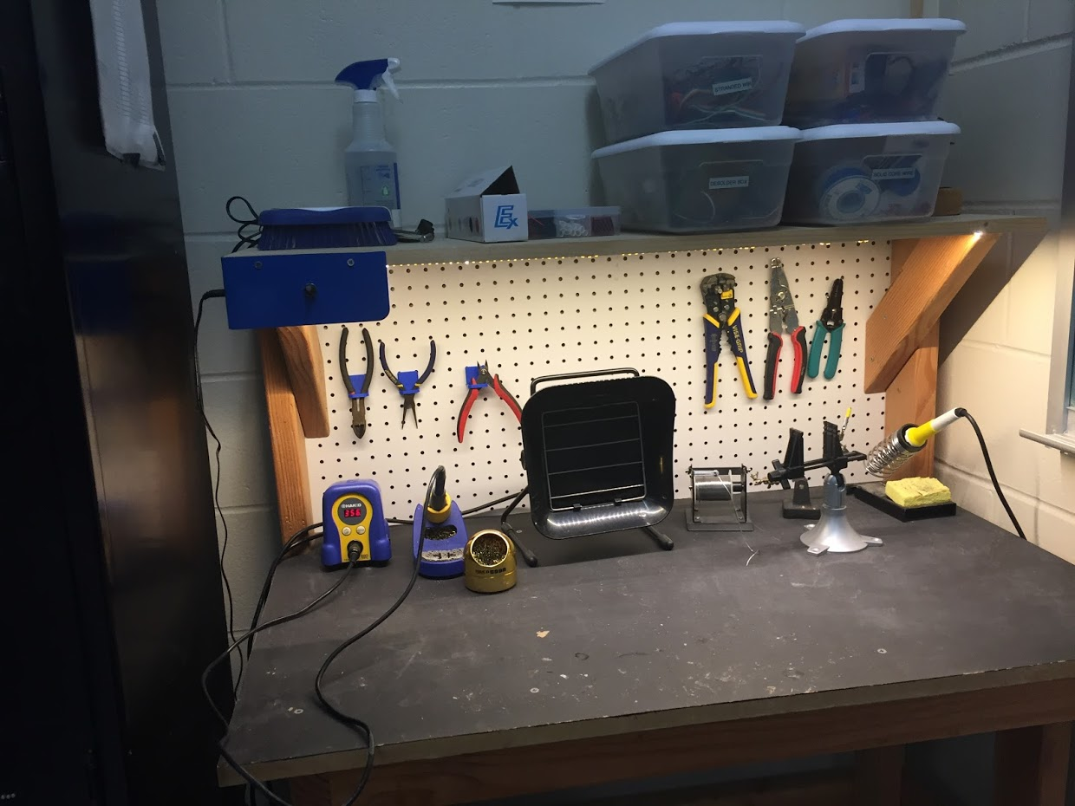
OUR LAB
Broun Hall
Room 367

Slide 6
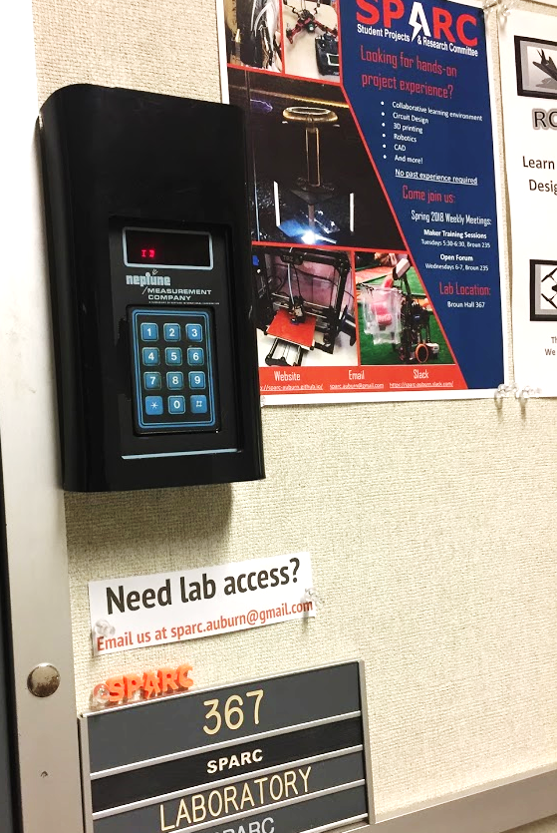
HOW TO BECOME A MEMBER
Log 5 constructive hours in the lab
Write the times on the sheet on the clipboard next to the door.
Contact us at sparc.auburn@gmail.com
We will respond with the instructions to get an access code.

Slide 7




MORE INFORMATION ABOUT SPARC
Website
http://sparc.eng.auburn.edu/
Github
https://github.com/SPARC-Auburn
Slack
https://sparc-auburn.slack.com/
Email
sparc.auburn@gmail.com

Slide 8

SPARC Sponsorship
We have been awarded a financial sponsorship of $1000.
This will help fund the IEEE robotics team and new lab supplies and equipment
Donated generously by Magna Decostar Industries Inc.
They are based in Carrollton, GA
Decostar manufactures and paints automotive front and rear fascia and bumpers for Mercedes, BMW, Nissan and Volkswagen (Pattillo Construction).

Slide 9
Spring 2018 Leadership Positions
Director of Projects
Keeps up with status of different projects
leads project open forum at meetings
assigns project leads
ensures projects will meet deadlines set
helps connect project leads with university, college, and department resources
Director of Lab Operations:
Keeps lab running smoothly
Identifies equipment needs
Maintains 3D printers
Organizes lab cleanup days
Ensures project and parts storage is well organized
Director of Public Relations
manages advertisements: website, flyers, white board announcements, etc.
manages outreach events: E-Day, robotics team mentoring, volunteer opportunities, demonstration tables, SCORE
helps SPARC obtain sponsorships
Attends e-council meetings and notifies other officers of notable topics (free Chick Fil A)
President:
Leads meetings
Reserves meeting rooms
Meets with the faculty advisor monthly
Sends out weekly newsletter
Maintains organization documentation
sets up meeting special topics
Vice President:
Functions as secretary/treasurer
Fills in for president when needed.
Ensures meeting attendance is recorded
reviews weekly newsletter sent by president
Manages organization finances and purchases
Coordinates occasional food at meetings

Slide 10
QUESTIONS?
Notes:
6:10

Slide 11
OUTREACH AND RECRUITMENT

Slide 12
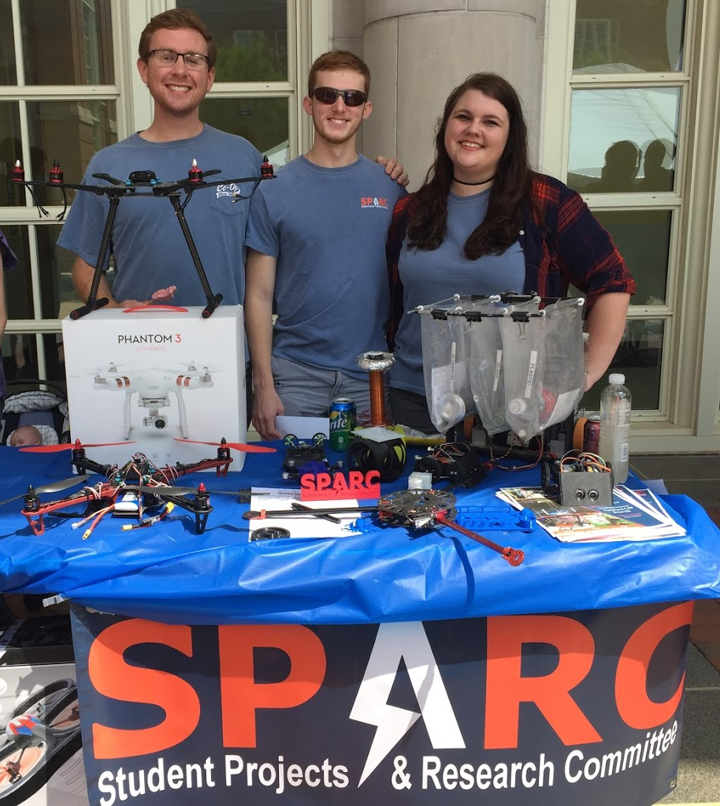
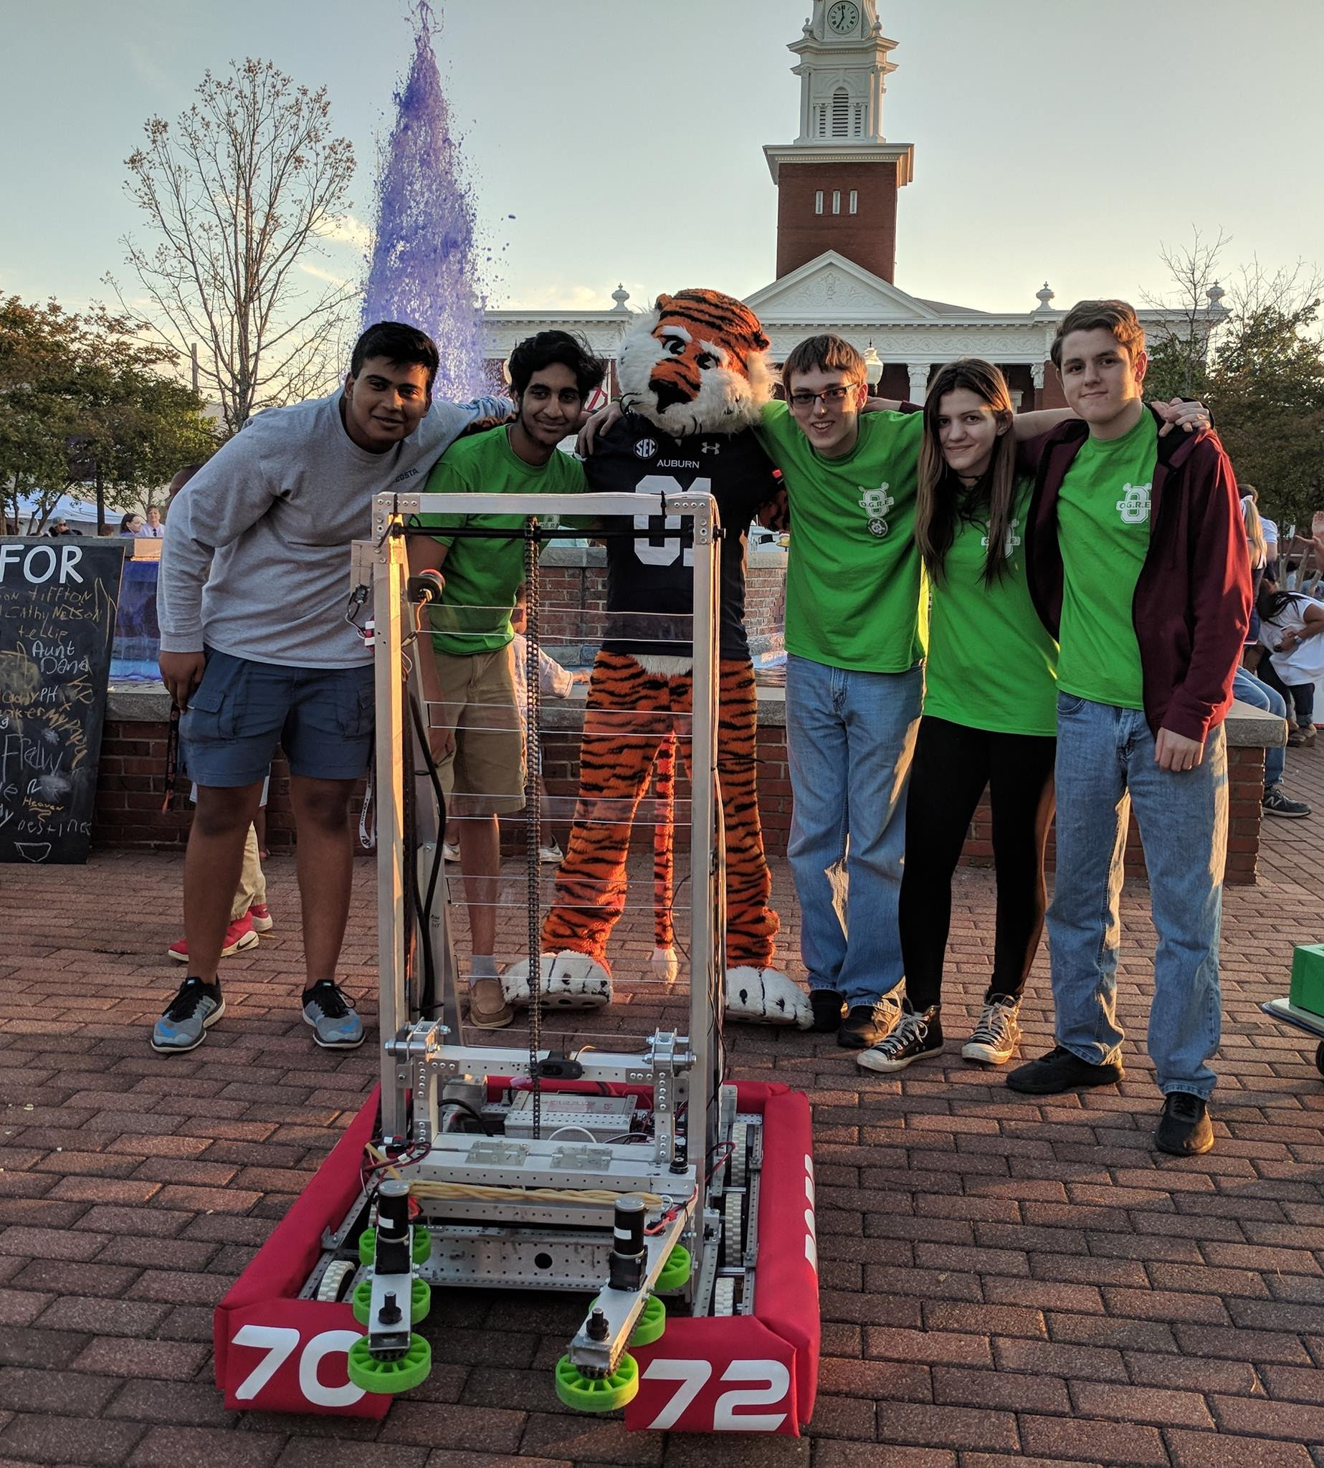
UPCOMING EVENTS
Opelika HS Robotics Team
Help mentor a local robotics team
Times: TWR: 3:30-6:30pm
Contact: Matthew Zacune <maz0006@auburn.edu>
Engineering BBQ 2018
FRC Team 7072 Bot
Notes:
Fall 2016
Loachapoka Robotics Mentoring- Mondays, Tuesdays, and Thursdays 3:00PM to 4:30PM
ECE Minority Presentation- November 14th
AJHS E-Day- November 17th
South’s Best- December 3-4th
SCORE Claw Machine- December 3-4th
Spring 2016
E-Day- Late February or early March
SPACE Day- Possible Event Next Semester
IEEE Sumo Robotics Competition (with local middle and high schools)- Spring 2017

Slide 13
PROJECT OPEN FORUM
Question of the day:
Project goals for E-Day

Slide 14
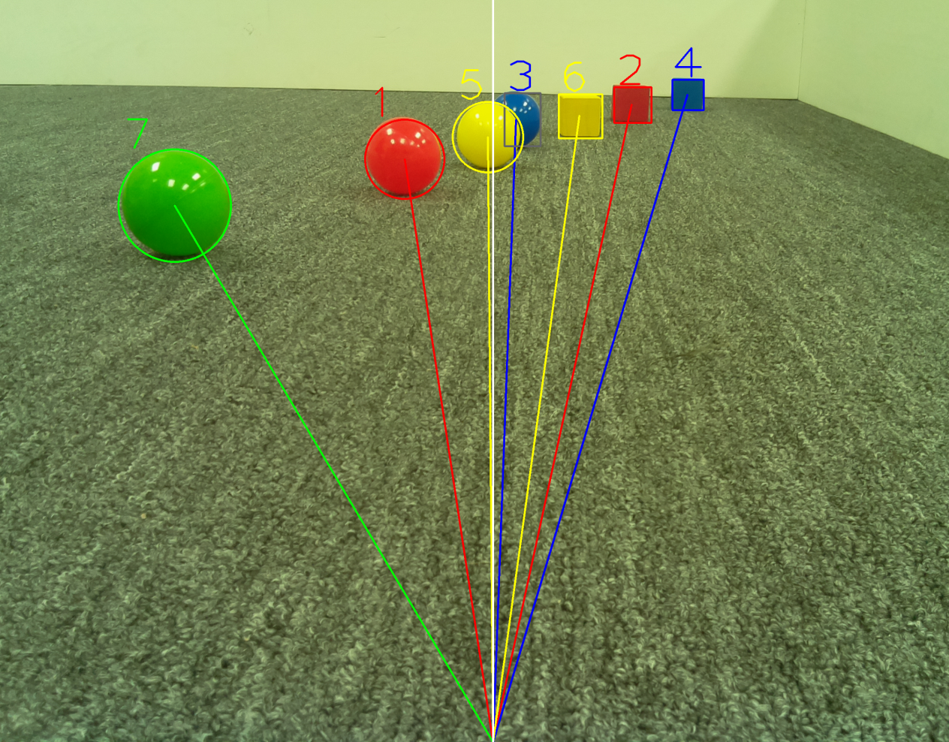
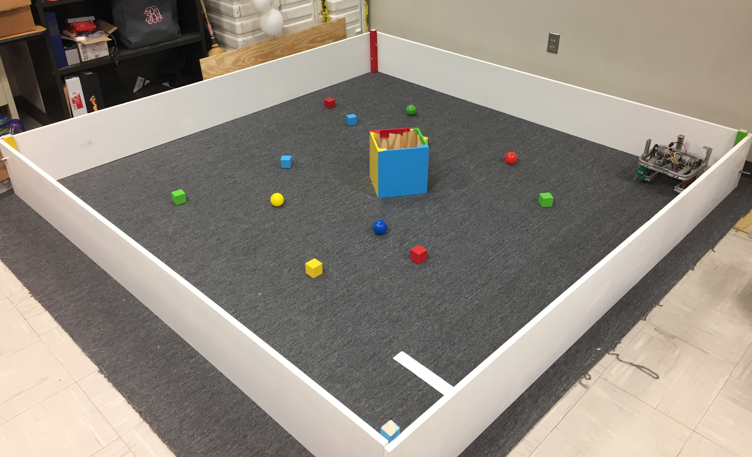
MAJOR PROJECT: IEEE SOUTHEAST CON
Project lead: Matthew Castleberry
Electrical lead: Josh Jablonowski
Mechanical lead: Alex Jones
Slack Channel: #projectieeeelectrical
Slack Channel: #projectieeemechanical
Competition Details:
Build a “space debris” collecting robot
Goal is to collect wood blocks and ball pit balls and deposit them on the side of a small flat ~100” square arena autonomously.
Max dimensions: 9” x 9” x 11”
When and Where:
Thursday, April 11th, 2019 through Sunday, April 14th, 2019.
IEEE Southeastcon conference in Huntsville, AL
Meeting Times
Electrical/Software Meeting: Tuesdays 12:30 - 2
Mechanical Meeting: Mondays 3 – 5
Programming Languages: C++,C
Gitlab: ask team lead for access

Slide 15
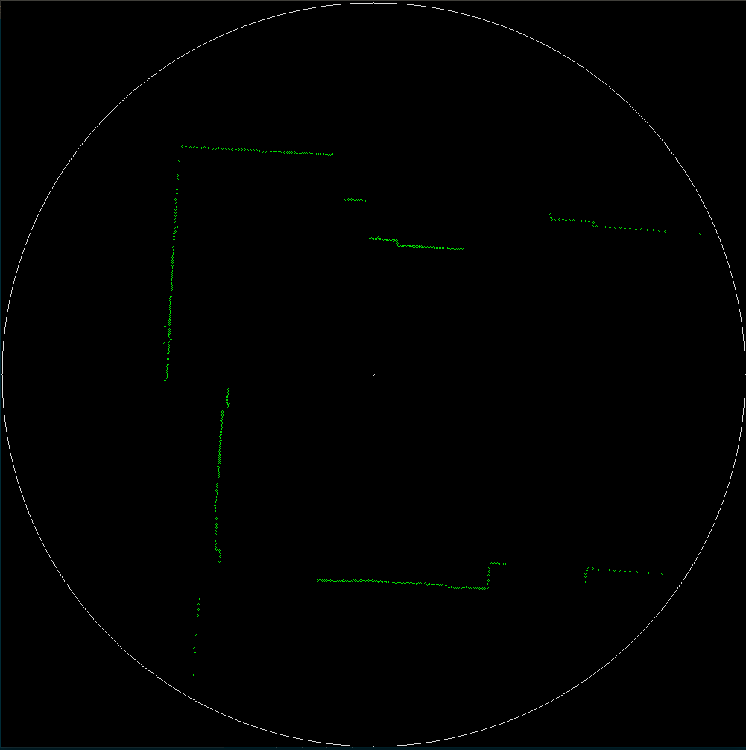
LIDAR Map

Slide 16
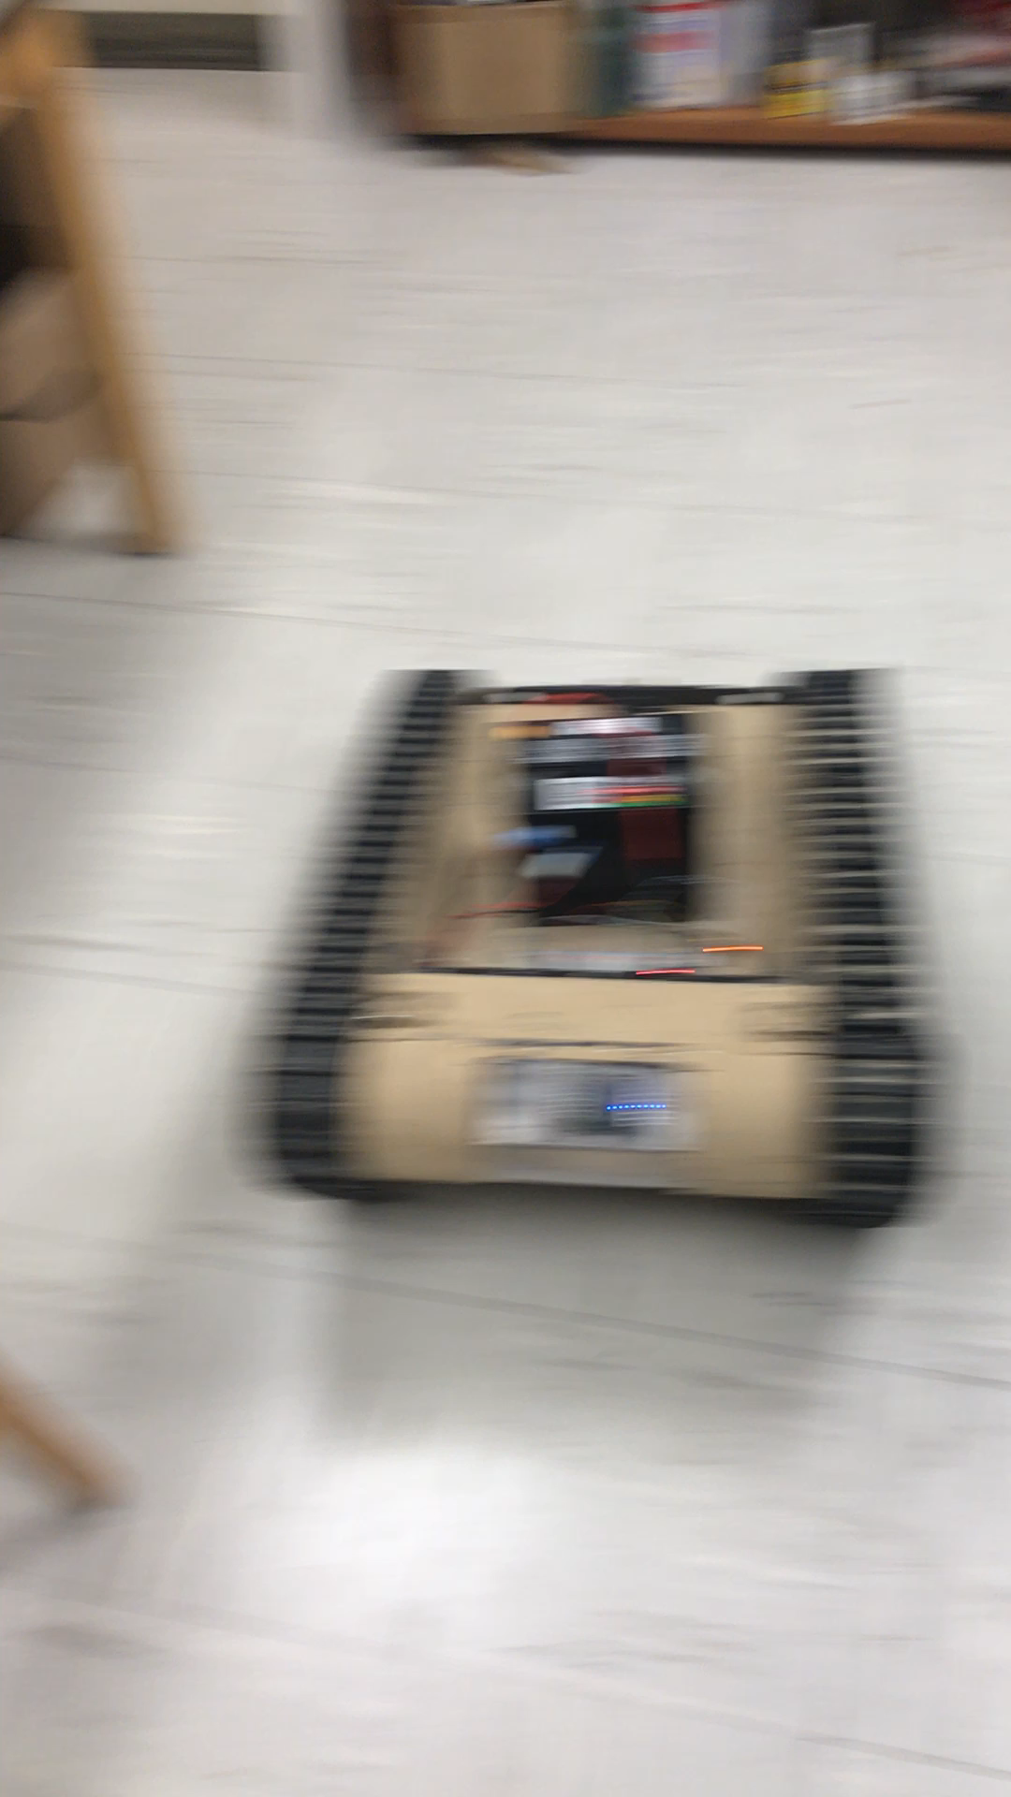
MAJOR PROJECT: MATILDA (Base)
Slack Channel: #projectmatildabase
Project lead: Ryan Moran
MATILDA stands for Mesa Associates' Tactical Integrated Light-Force Deployment Assembly
A bomb disposal robot from Dr. Roppel’s research lab.
Meeting Time:
Fridays 11:30 – 12:30
Semester Focus
Reestablishing mobility with wireless control
Establish autonomy with OpenCV
Potential add T-Shirt cannon to top
Github Repository
https://github.com/SPARC-Auburn/MATILDA-Base
Programming Languages
Python w/ OpenCV
C

Slide 17
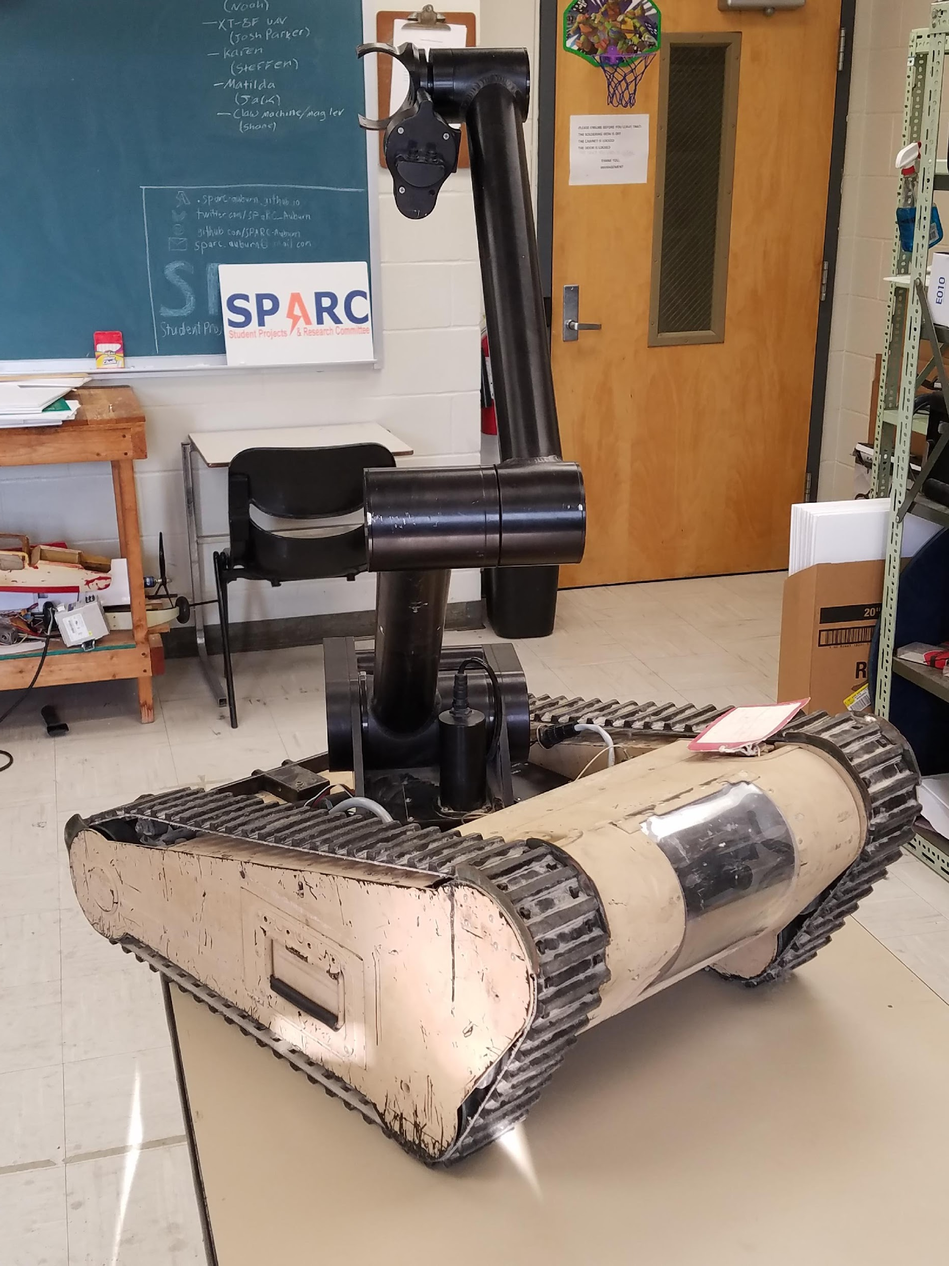
MAJOR PROJECT: MATILDA (Arm)
Slack Channel: #projectmatildarm
Project lead: Alex Jones/Rice Shelley
MATILDA stands for Mesa Associates' Tactical Integrated Light-Force Deployment Assembly
A bomb disposal robot from Dr. Roppel’s research lab.
Meeting Times:
Thursdays 12:30 - 2
Semester Focus
Reestablishing arm control
Develop arm to play chess
Github Repository:
https://github.com/SPARC-Auburn/MATILDA-Arm
Programming Languages
Python w/ OpenCV
C

Slide 18
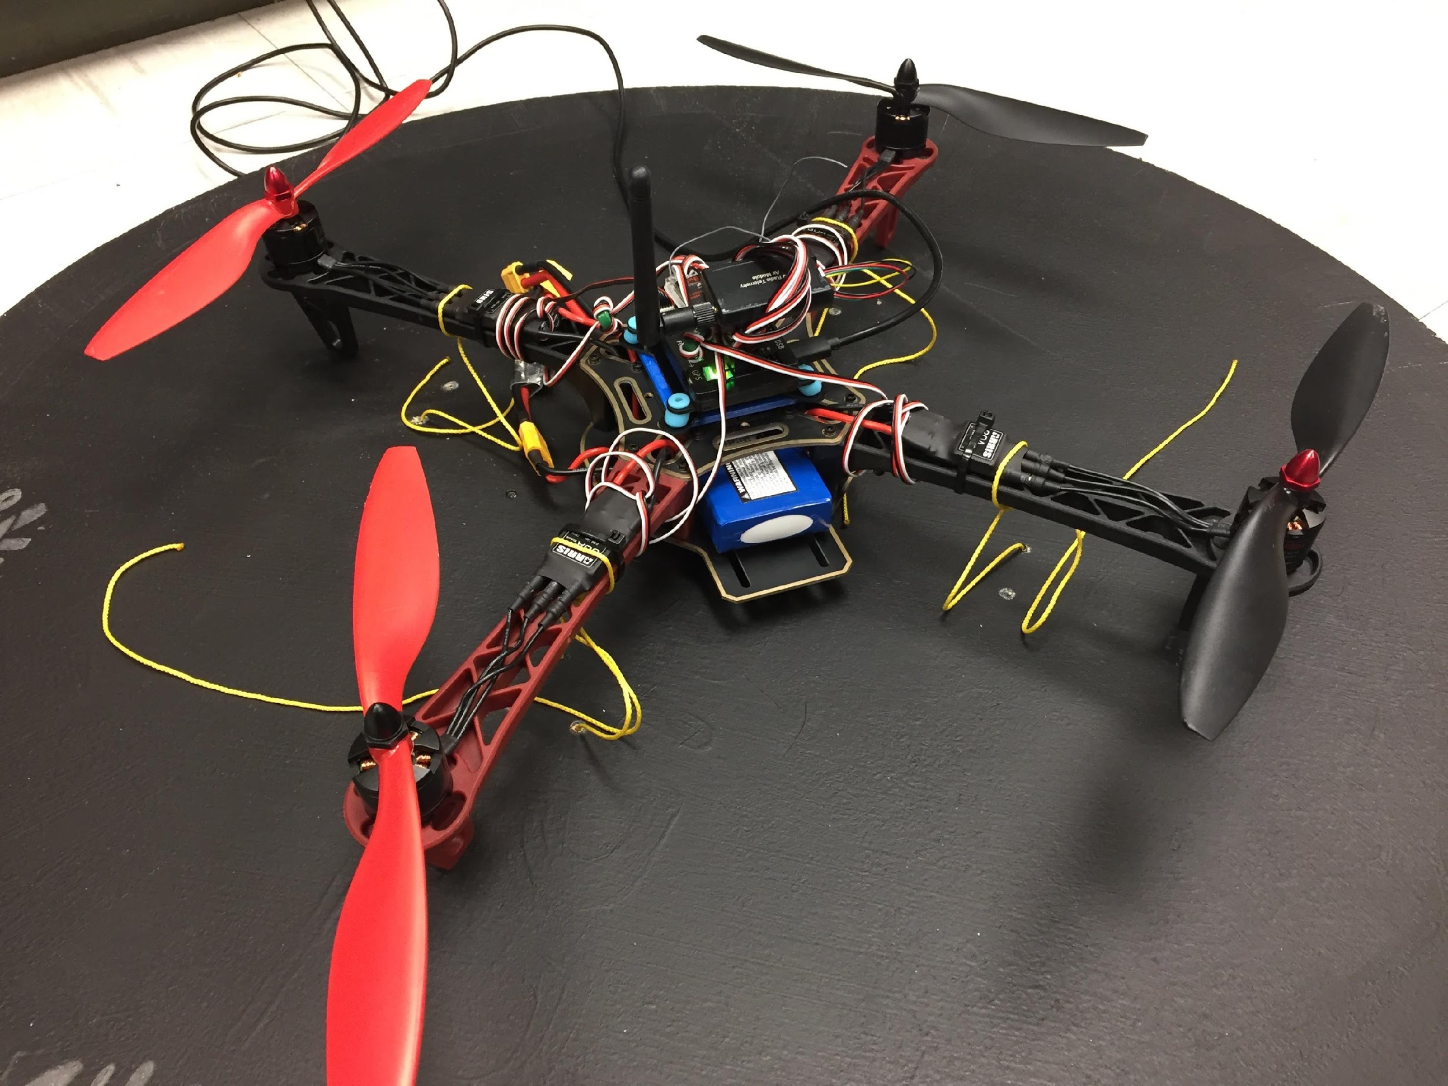
MAJOR PROJECT: MAIL BIRD
Project Lead: Joshua Parker
Slack Channel: #projectmailbird
Will be used to experiment with payload pickup, identification, and delivery
Partnership with RC Hobbyist Club
Semester Focus
Configure frame for waypoint navigation, etc.
Develop package release mechanism
Meeting Times
Wednesdays 11am – 1pm

Slide 19
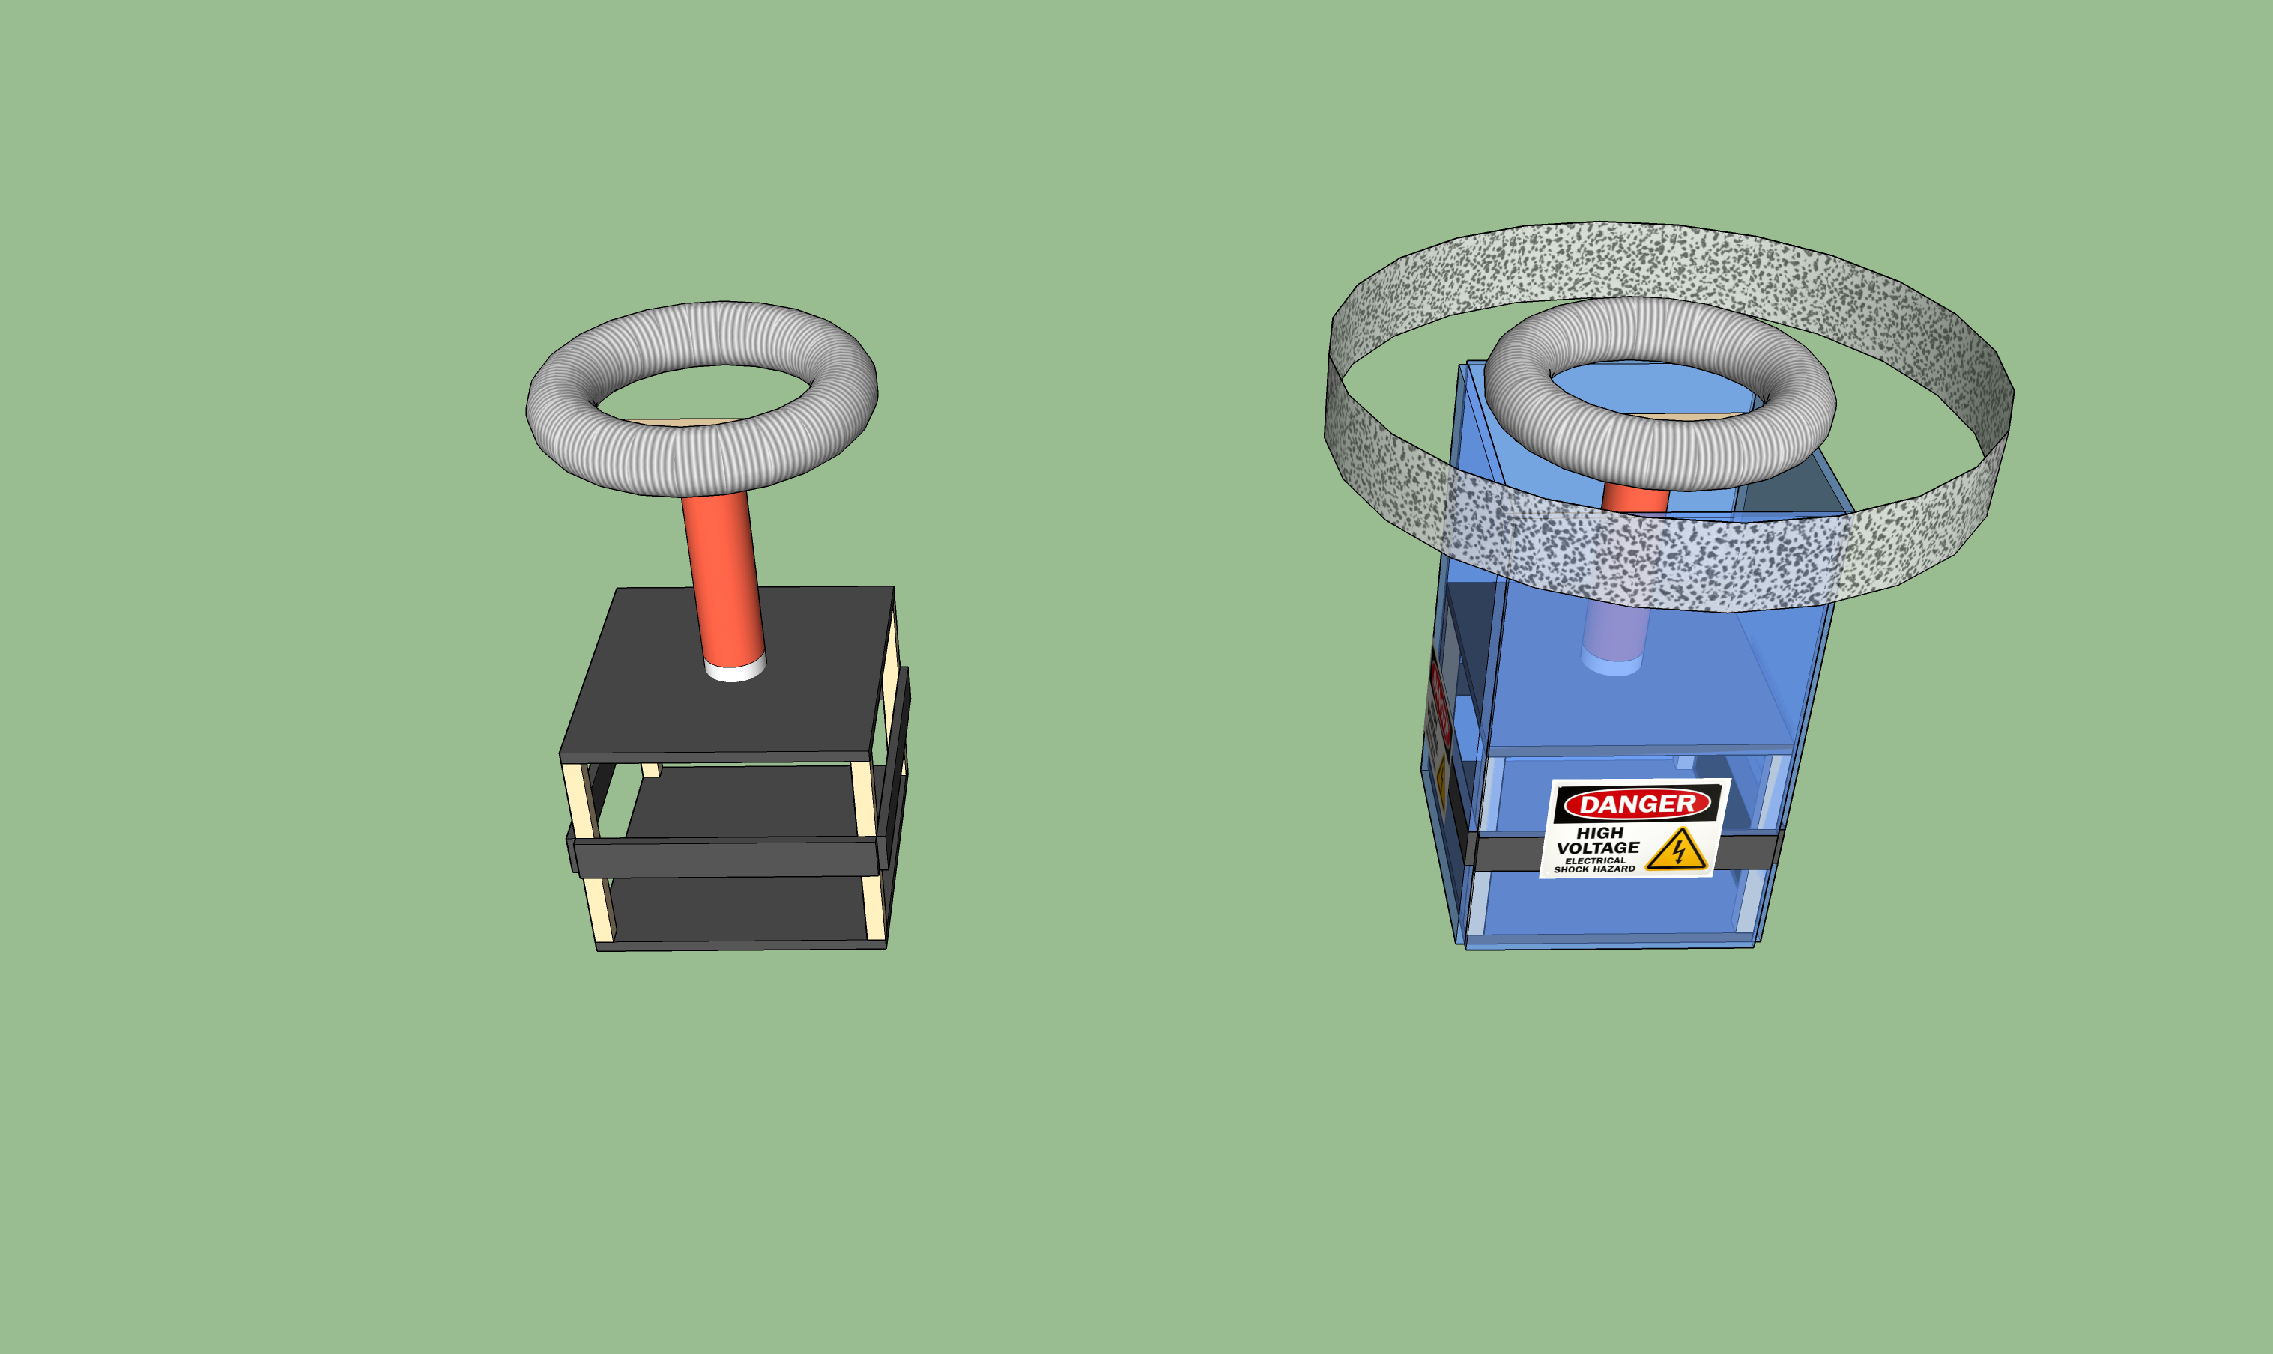
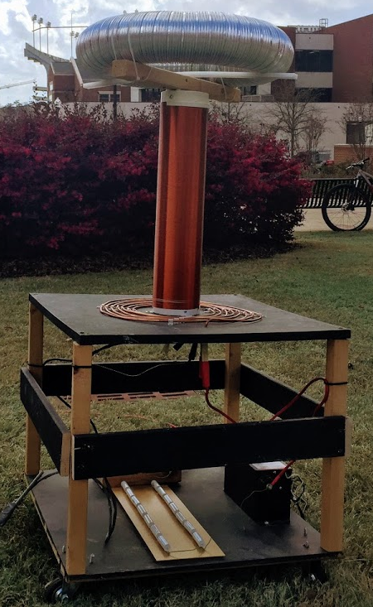
SIDE PROJECT: MUSICAL TESLA COIL
Project lead: Neil Postal
Slack Channel: #projectteslacoil
Demonstrated Tesla Coil at Spring 2016/18 E-Days
Currently uses spark gap style circuitry
Generated estimated 400,000 volts of electricity.
Semester Focus:
Increase safety precautions
Change from spark-gap design to solid-state design
Develop MIDI-input to allow music
Meeting times: Thursdays @ 3:30
Github: https://github.com/SPARC-Auburn/Tesla-Coil
Current Design
Possible safety precautions

Slide 20
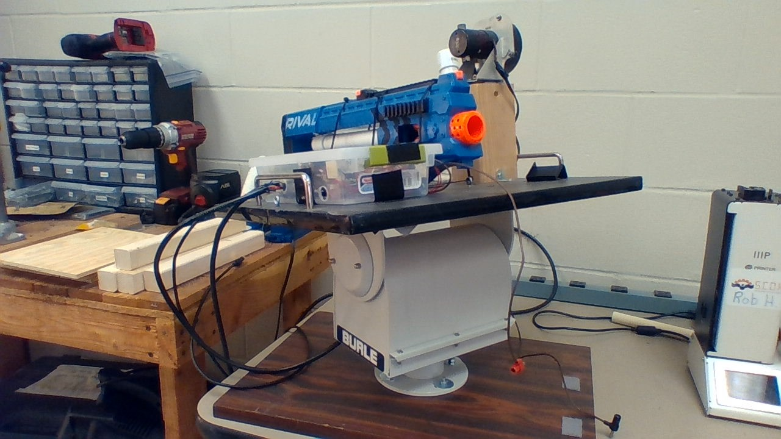
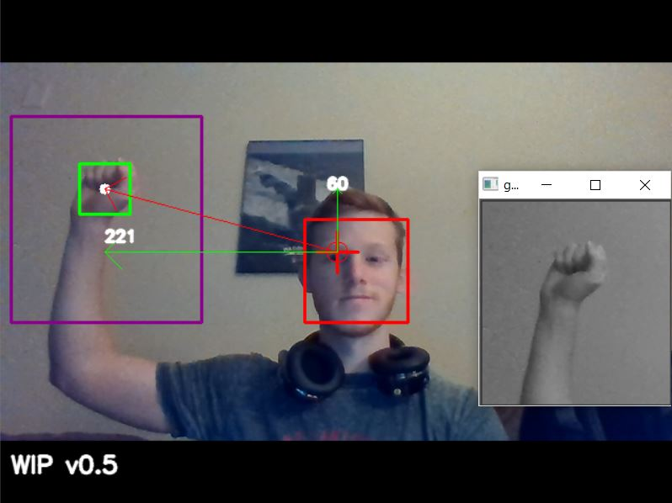
SIDE PROJECT: The Helpful Automated Defender (THAD)
Project lead: Josh Jablonowski
Slack Channel: #projectthad
Old project donated by EE department
It was demonstrated last spring at E-Day and PEAK.
Needs a new purpose to improve demonstrations
Github Repository:
https://github.com/SPARC-Auburn/THAD
Programming Languages
Python w/ OpenCV
C

Slide 21
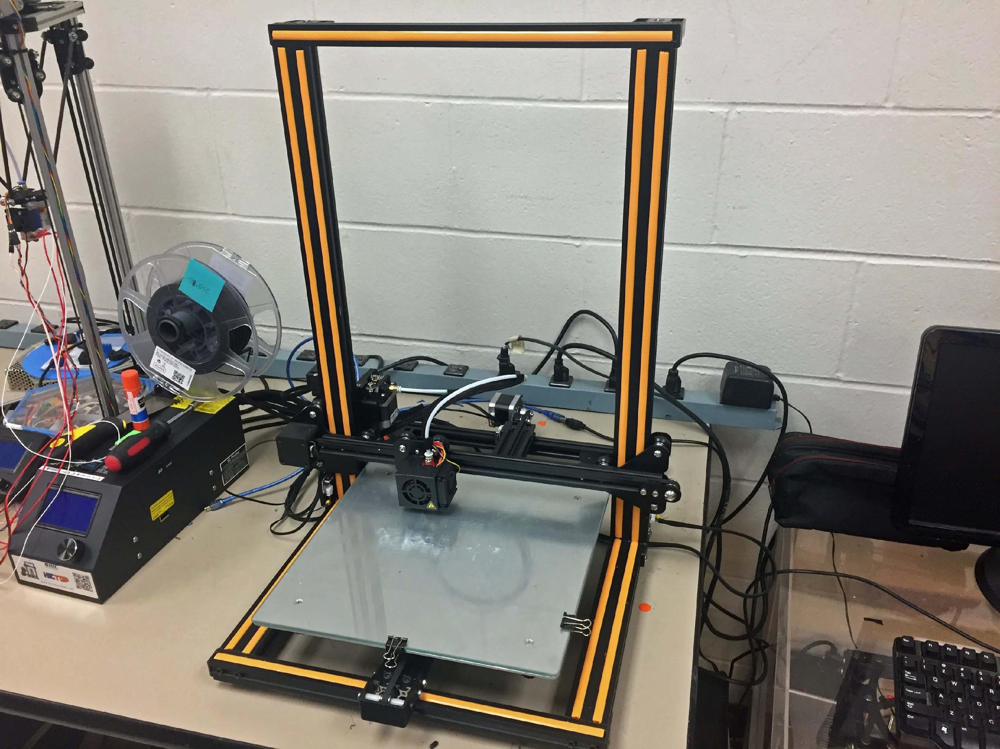
SIDE PROJECT: 3D PRINT ENCLOSURE
Project lead: Alex J. and Josh J.
Slack Channel: #3dprinting
Design double decker 3D printer enclosure to hold our Creality CR10 and Lulzbot Taz 3.
Will have wheels and have hinged doors
Will be a potential requirement based on new campus 3D printing rules.

Slide 22
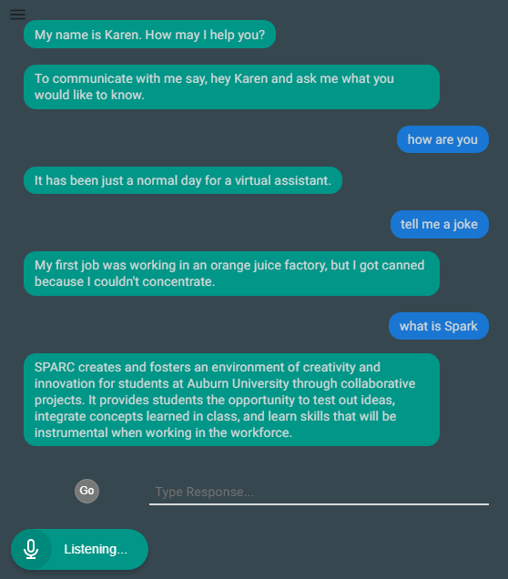
SIDE PROJECT: LAB ASSISTANT
Kinematic
Autonomous
Robot
Enriches
Newcomers
Lab
Information
Support
Tool
Project lead: Arthur Howard
Slack Channel: #projectlabassistant
Goal: create an automated lab assistant.
Is voice controlled.
One day will consist of both a stationary and mobile system.
Can be embedded on the new group chat system Slack.
Programmed in Node.JS (Framework of JavaScript)
Semester Focus
Add functionality
Add database for keeping track of members and equipment
Github Repository:
https://github.com/SPARC-Auburn/Lab-Assistant-IO
Programming Languages
Node.JS
Notes:
6:30

Slide 23
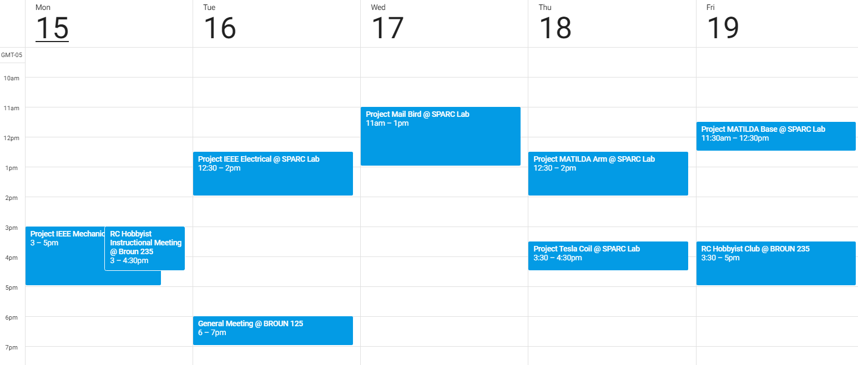
Meeting Schedule

Slide 24
PROJECT IDEAS?
email us at sparc.auburn@gmail.com
or DM Matthew Castleberry @mcberry23 via Slack

Slide 25
Maker Training Session:
Arduino (Part II)
The Possibilities with Arduino

Slide 26

Why an Arduino?
Great for Rapid Prototyping
Inexpensive
Open Source Software
Easy to Learn (Abundance of Tutorials)

Slide 27
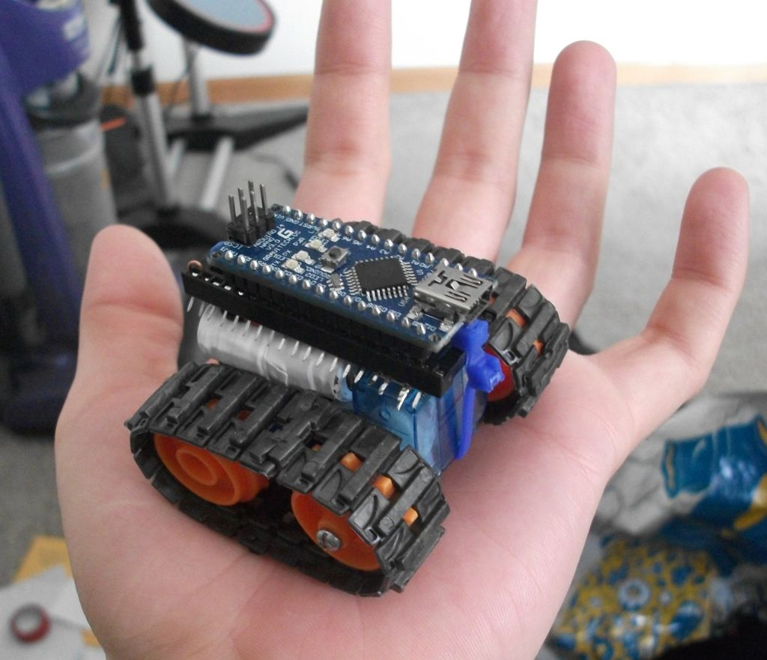
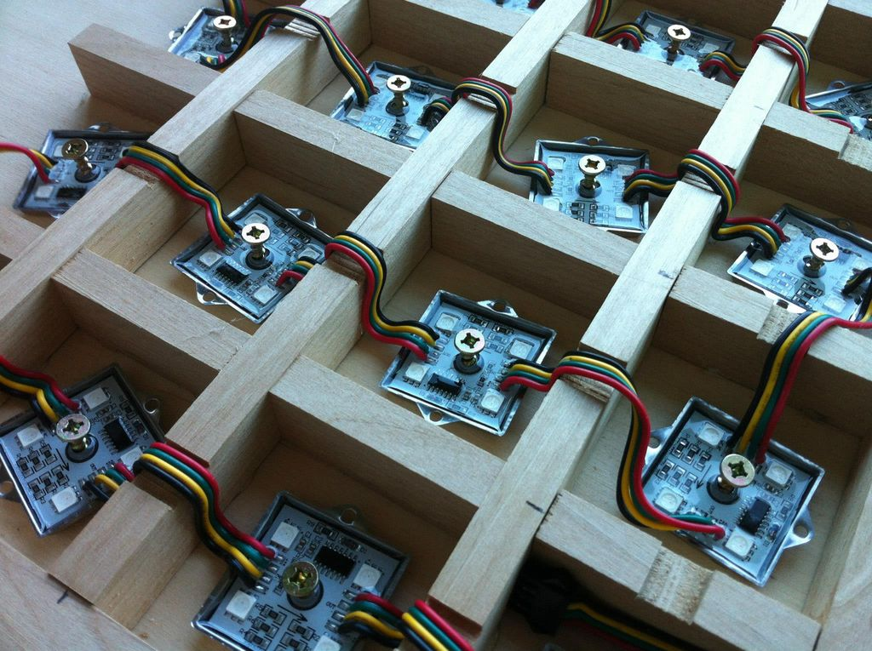
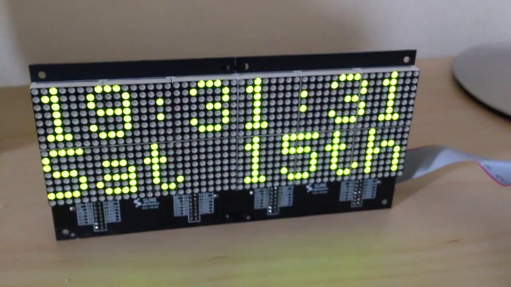
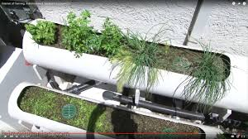
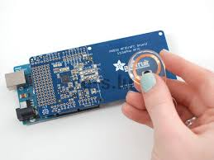
Some Example Applications

Slide 28
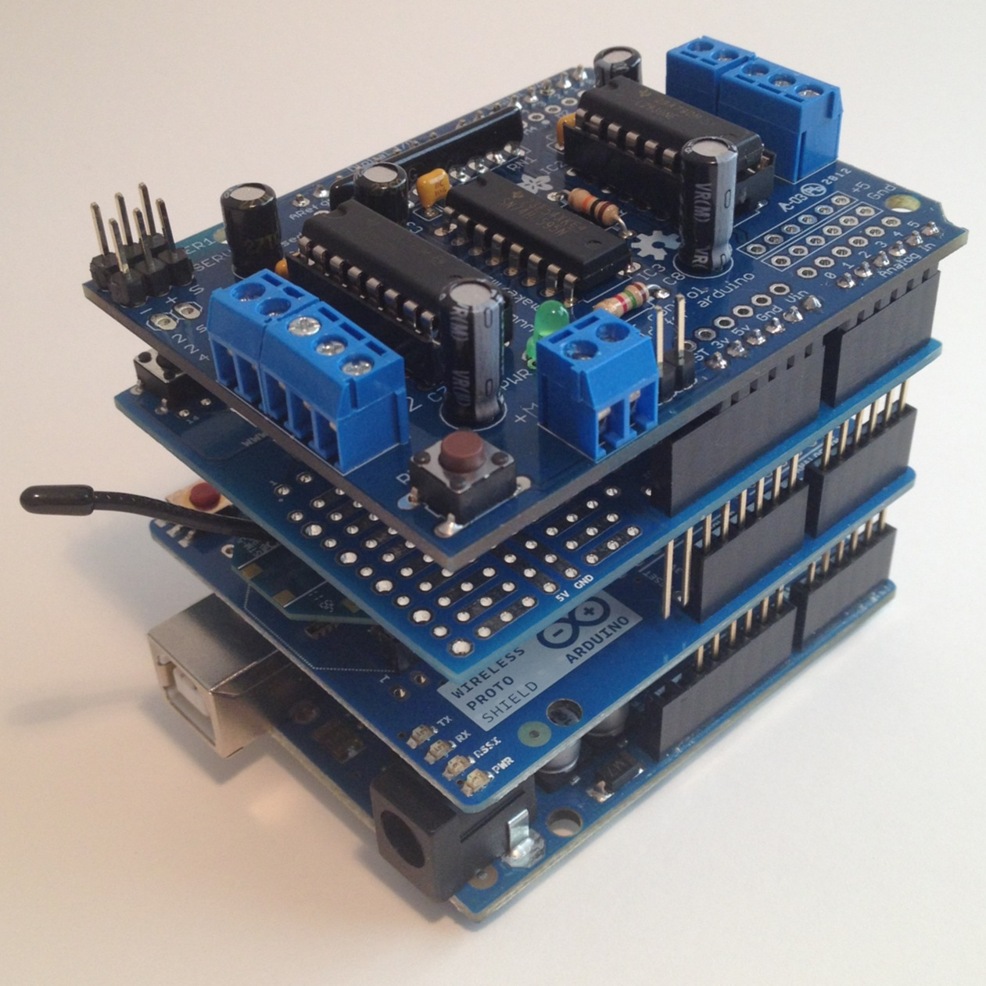
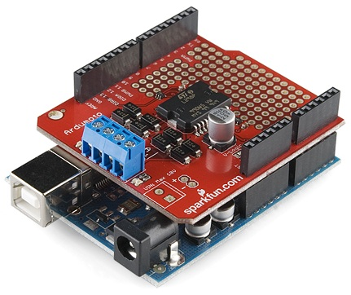
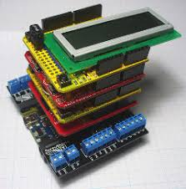
Arduino Shields
Adds more functionality to your Arduino
Can be easily stacked
You can make your own
Motor Control
WiFi/Bluetooth
LCD Screens
RFID Readers

Slide 29
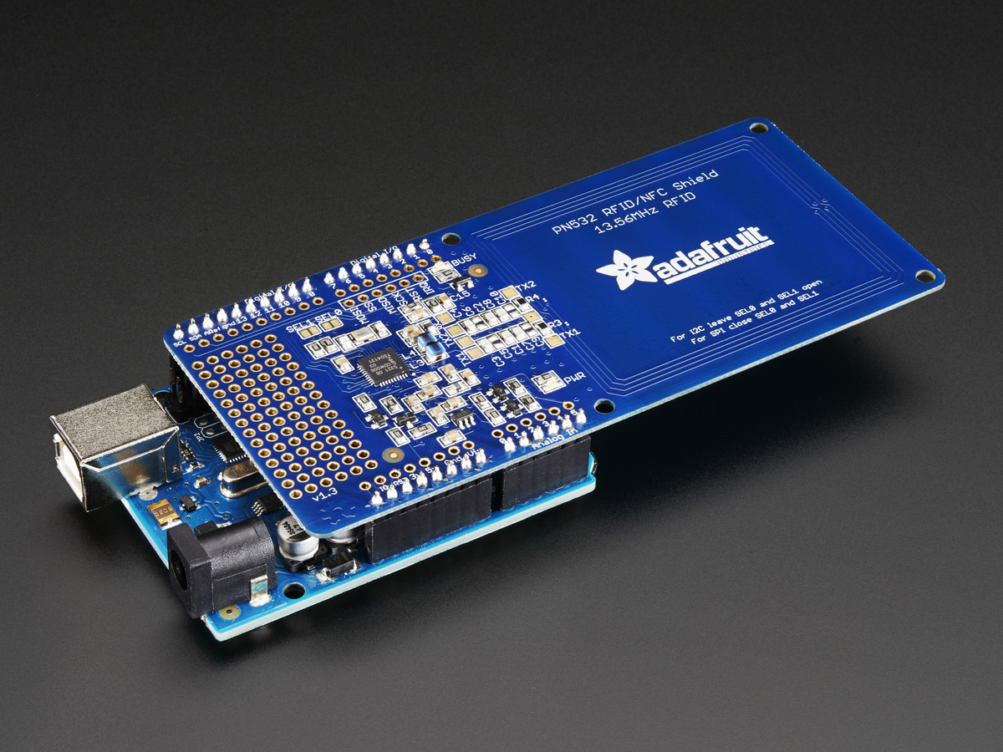
RFID Demo

Slide 30
THAD (The Helpful Automated Defender)

Slide 31
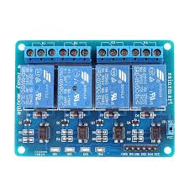
How It Works
Uses communcation via Serial to the Arduino
Sends characters that correspond to directions
Turns on the respective relay from its DIO port
OpenCV does all the logic for which direction to go
Unrelated to Arduino

Slide 32
THAD Demo

Slide 33
Serial Communication (To Arduino)
(Code Writing Demo; make THAD move)

Slide 34
QUESTIONS?

